Slide 1
Heart Disease Data analysis

Slide 2
Objectives
Aim was to investigate relationships between physiological measurements and heart disease diagnosis
Key questions:
Does maximum heart rate (thalach) differ between people with and without heart disease?
Does resting blood pressure (trestbps) differ between groups?
Does chest pain type (cp) affect max heart rate?
Is there an association between chest pain type and heart disease diagnosis?

Slide 3
Dataset
Heart Disease Dataset
Statistical methods used:
Two-sample t-test
ANOVA
Tukey’s HSD Test
Chi-Square test
Variable | Description
thalach | Maximum heart rate achieved
trestbps | Resting blood pressure
cp | Chest pain type
heart_disease | Diagnosis of heart disease

Slide 4
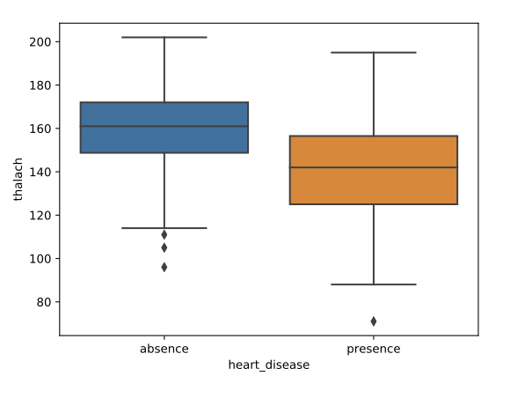
Maximum heart rate analysis
T-test: thalach vs Heart Disease:
Compared average max heart rate between
Patients with heart disease
Patients without heart disease
Null hypothesis:
The average maximum heart rate is the same for patients with and without heart disease.
Alternative hypothesis:
The average maximum heart rate differs between the two groups.
Result: p-val <0.05, we reject the null hypothesis.
Max Heart rate significantly differs between the two groups.

Slide 5
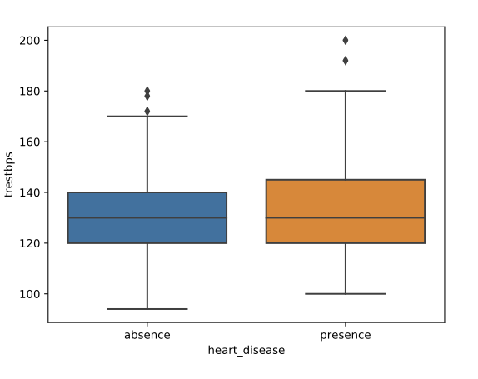
Resting blood pressure analysis
T-test: trestbps vs Heart Disease
Does resting blood pressure differ significantly between patients with and without heart disease?
Result: p-val < 0.05, therefore there is a statistically significant difference in resting blood pressure between the two groups.

Slide 6
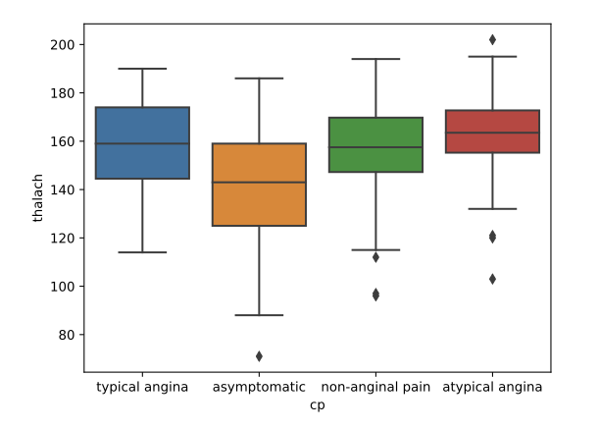
Chest pain type and heart rate
ANOVA test
Tested whether average maximum heart rate differs between chest pain types.
Result: p-val < 0.05
At least one chest pain group has a significantly different average maximum heart rate.
To determin which groups differed, we used Tukey’s HSD test, which identified the specific pairs with significant differences.
Because there are four chest pain categories, a t-test cannot be used. ANOVA allows comparison of the mean maximum heart rate across multiple groups.

Slide 7
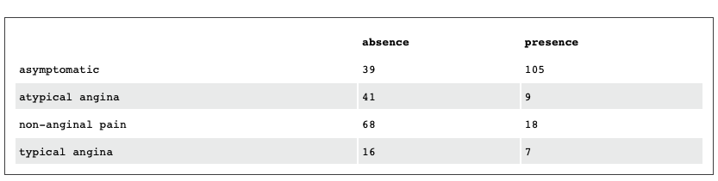
Chest pain and heart disease
Chi-Square test
Examined whether chest pain type is associated with heart disease diagnosis
Table shows counts of patients with and without heart disease across chest pain types.
Result: p-val <0.05 meaning there is a significant association between chest pain type and heart disease diagnosis

Slide 8
Conclusions
Key Findings
The analysis revealed several important relationships:
Maximum heart rate differs significantly between individueals with and without heart disease.
Resting blood pressure also shows a significant difference between groups.
Chest pain type is associated with differences in maximum heart rate
Chest pain type is strongly associated with heart disease diagnosis
Overall, chest pain type and physiological measurements appear to be important indicators of heart disease risk.

